Slide 1
Installing Drupal 8 and Commerce 2 on a Shared Web Host
Installing D8 + Commerce On Shared Web Host
http://cms-freelancers.com/myd8store/web/

Slide 2
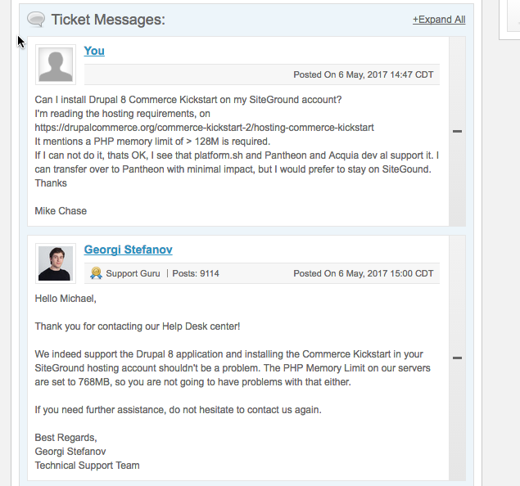
Checking with SiteGround, CYA

Slide 3
Commerce 2 Commands
Download the Folders & Files:
composer create-project drupalcommerce/project-base xxxx --stability dev
Where xxx is the folder name or we will use . To download into the current folder

Slide 4
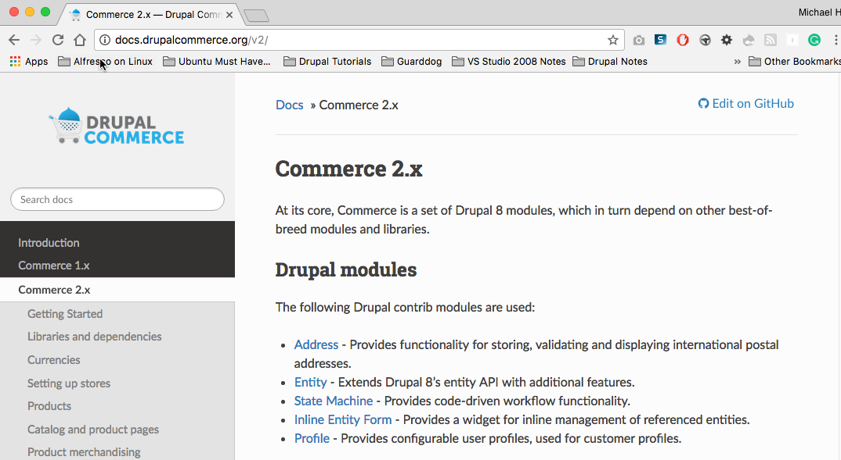
http://docs.drupalcommerce.org/v2/getting-started/index.html

Slide 5
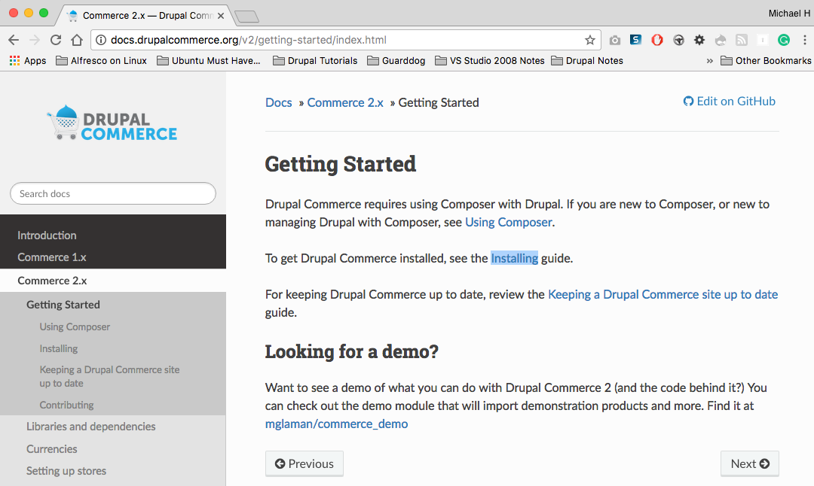
http://docs.drupalcommerce.org/v2/getting-started/index.html

Slide 6
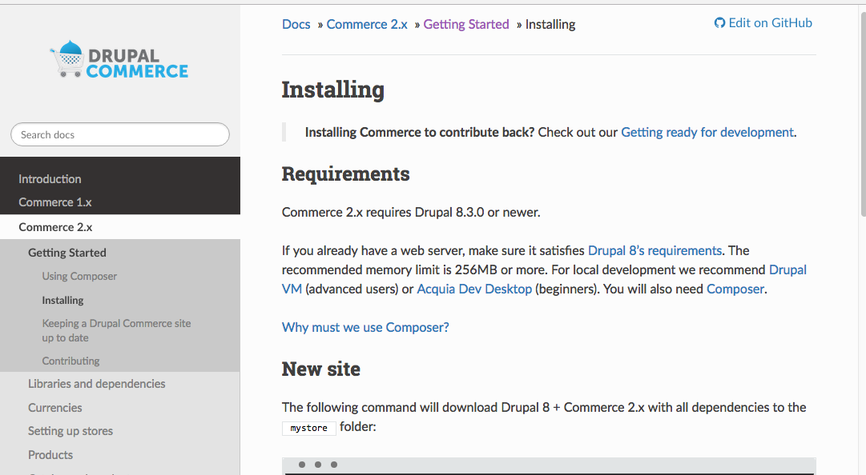
http://docs.drupalcommerce.org/v2/getting-started/install.html

Slide 7
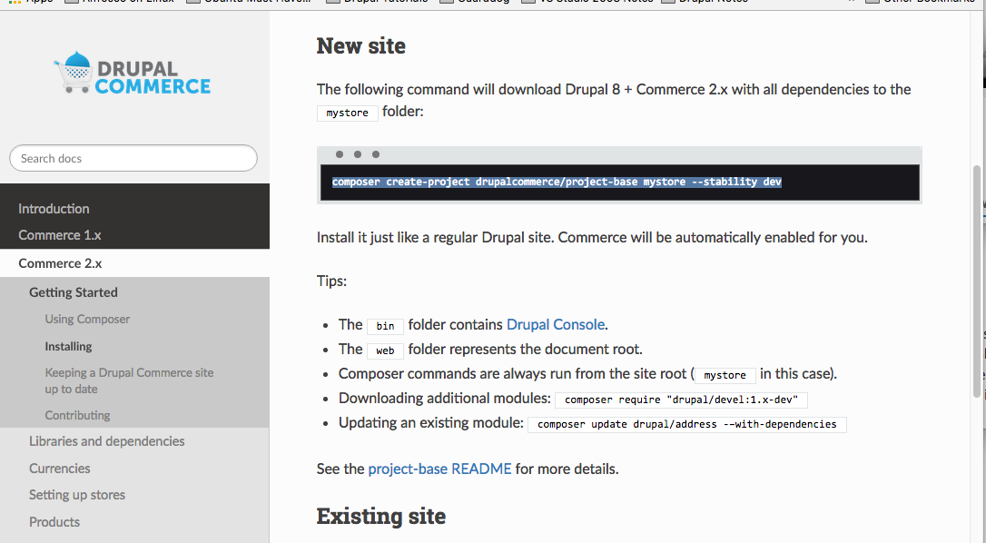
http://docs.drupalcommerce.org/v2/getting-started/install.html

Slide 8
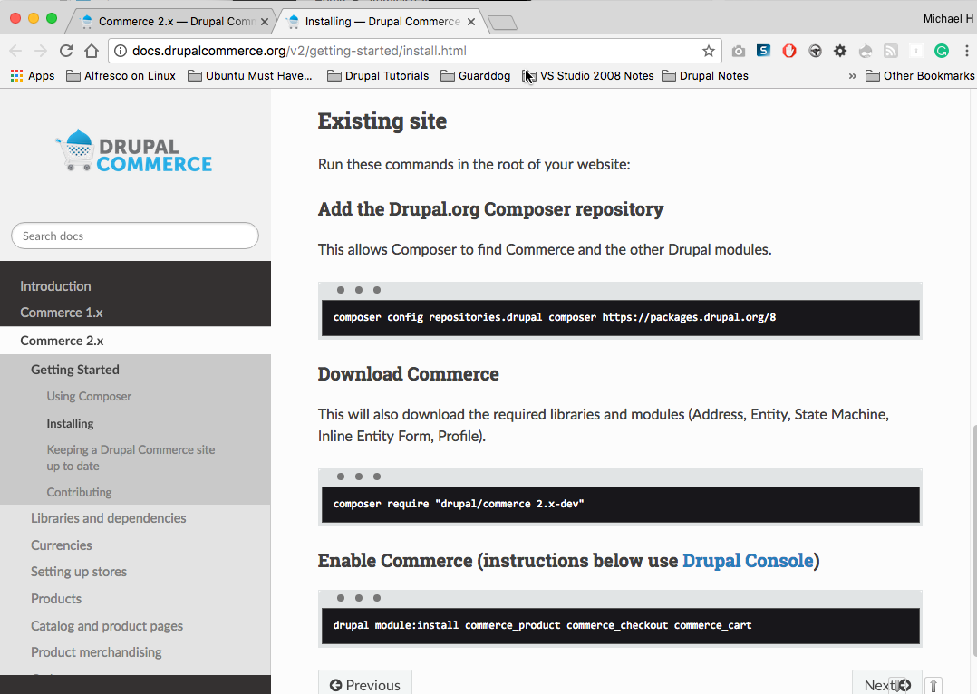
http://docs.drupalcommerce.org/v2/getting-started/install.html

Slide 9
What I’m going to try – Part 1
Create a new folder under public_html named mhcd8store
Create a MySQL database named mystoredb (cmsfreel_mystoredb)
Create a user (cmsfreel_mchase) and assign the user to the database and give that use all privileges
SSH into my SiteGround server
Setup Private Passcode on SiteGround & local computer
Navigate to my web myd8store folder
Check to see if Composer already installed
Composer –V
It was already installed.
Install composer if its not on my Siteground, or ask SiteGround Tech Support to do the composer install
CD to myd8store folder
Download the commerce file with the command
composer create-project drupalcommerce/project-base . --stability dev
Open a web browser and navigate to the web store folder and run the install
http://cms-freelancers.com/my8store/web/core/install.php

Slide 10
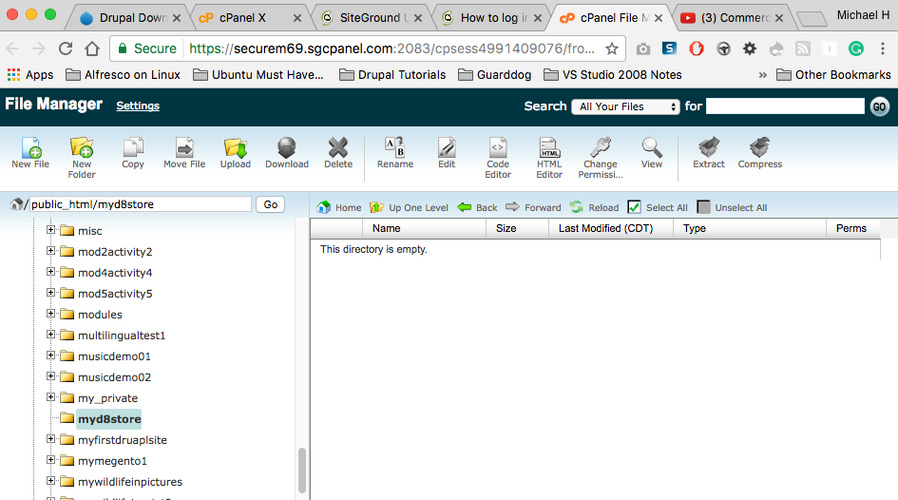
Establish my store folder myd8store

Slide 11
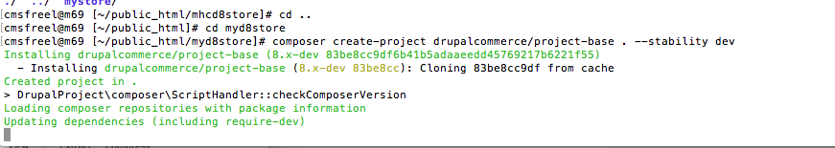
Running the Composer command to download the D8 Commerce 2 folder and files to the SiteGround mystore web folder

Slide 12
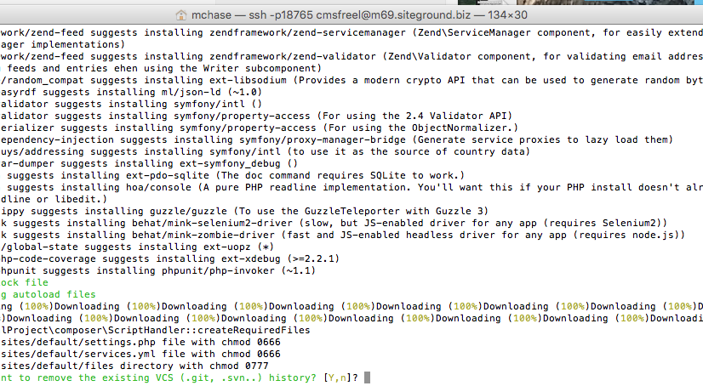
Composer command wrapping up, Yes to delete the history

Slide 13
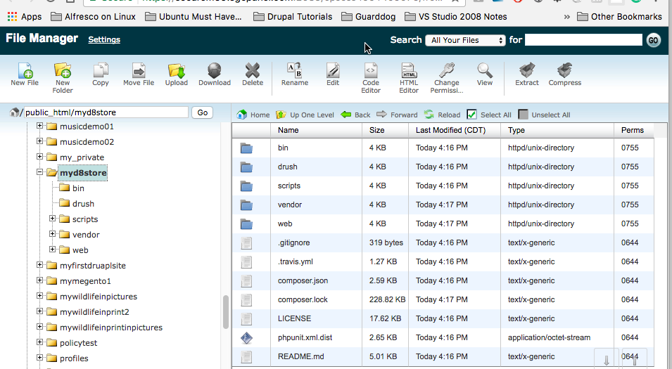
myd8store folders and files downloaded

Slide 14
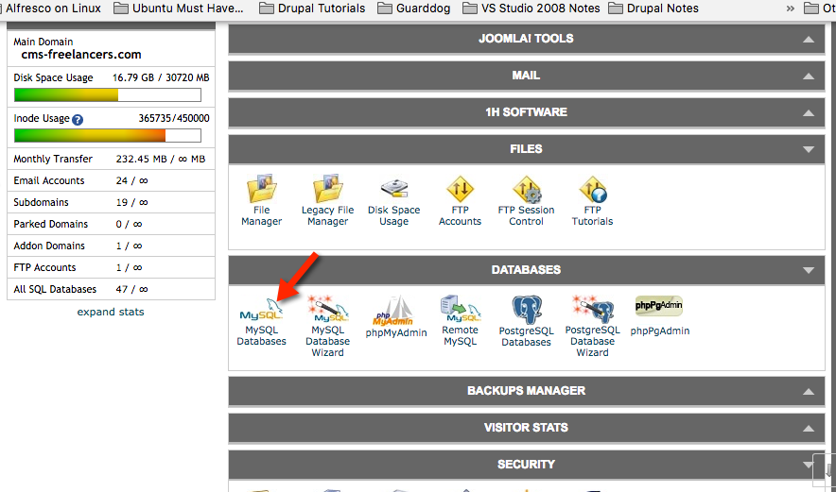
Create a MySQL db for the D8 site We need an existing DB before we can run the install (Open MySQL, not phpMyAdmin)

Slide 15
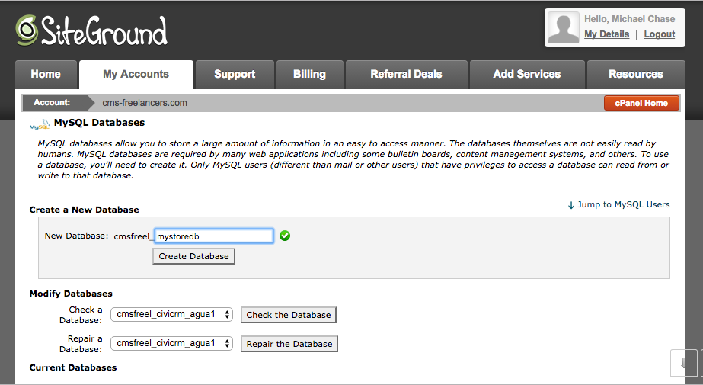
DB Part 1: create the DB

Slide 16
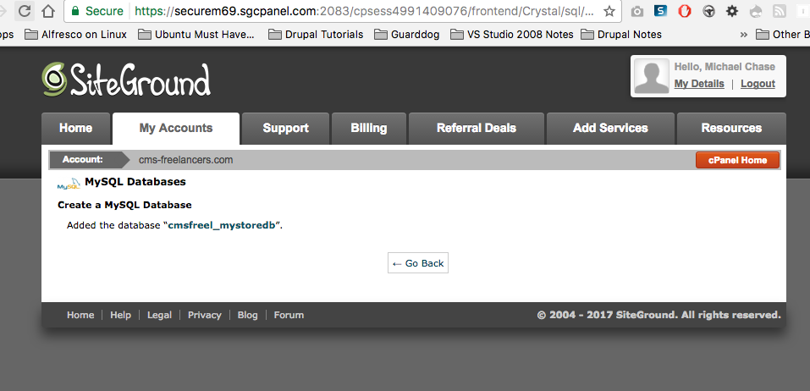
DB Created: NOTE DB name has your domain username as its prefix

Slide 17
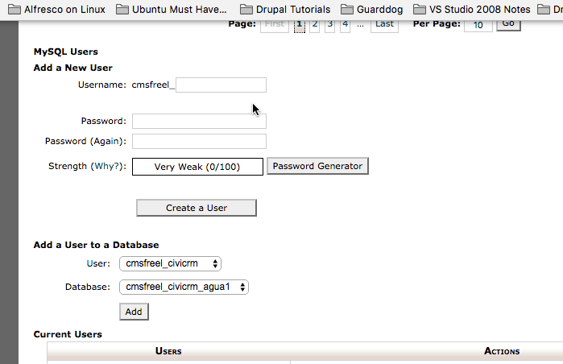
DB Part 2: Create a DB user

Slide 18
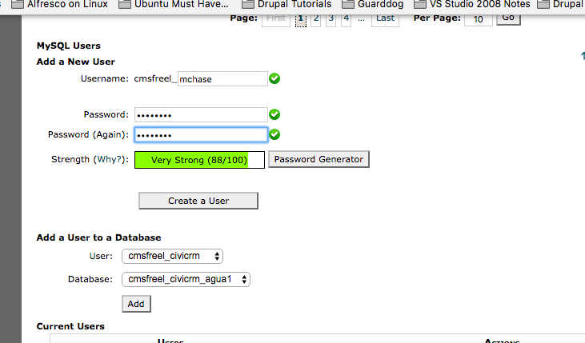
Please note the username has your domain user name as its prefix

Slide 19
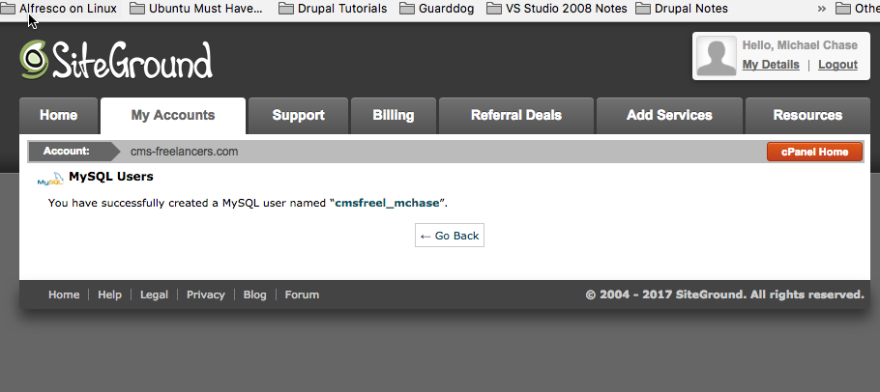
DB username created

Slide 20
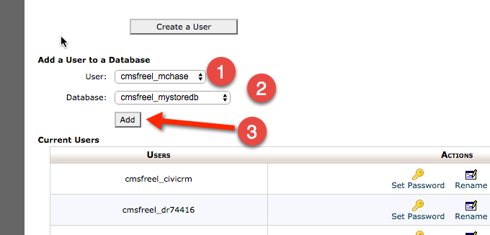
DB Part 3: Assign DB user to our DB

Slide 21
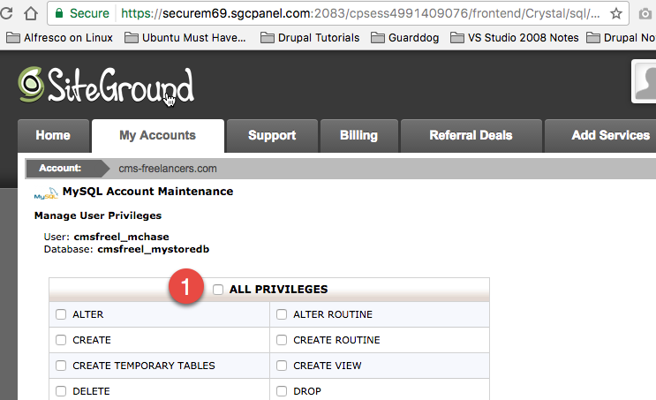
Part 4: Give DB User all privileges

Slide 22
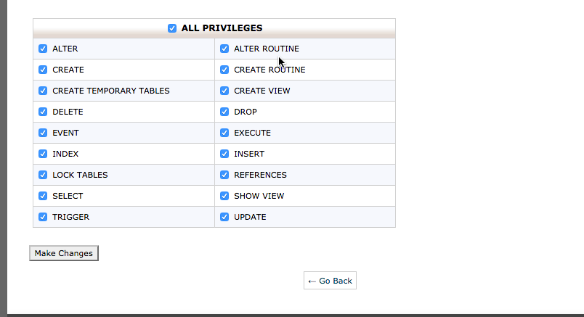
Assign all privileges and Make Changes

Slide 23
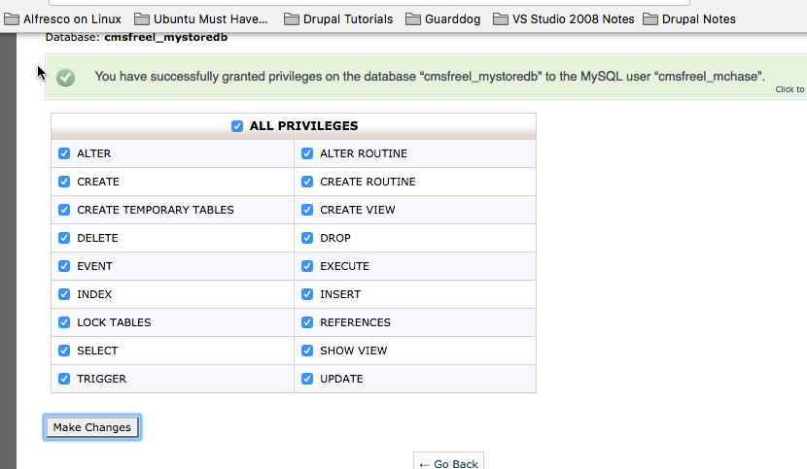
DB User has all privileges

Slide 24
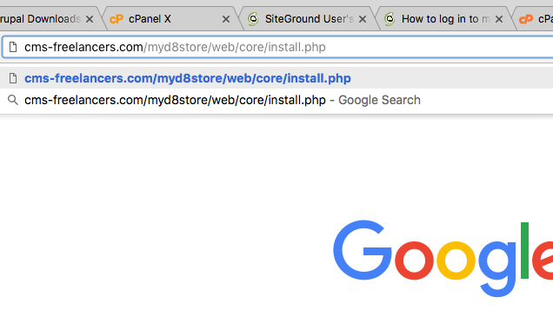
Open a browser, navigate to our web folder install script (folder/web/core/install.php)

Slide 25
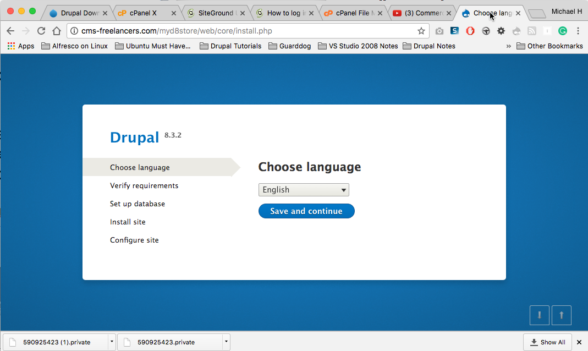
Start the D8 Site Installation

Slide 26
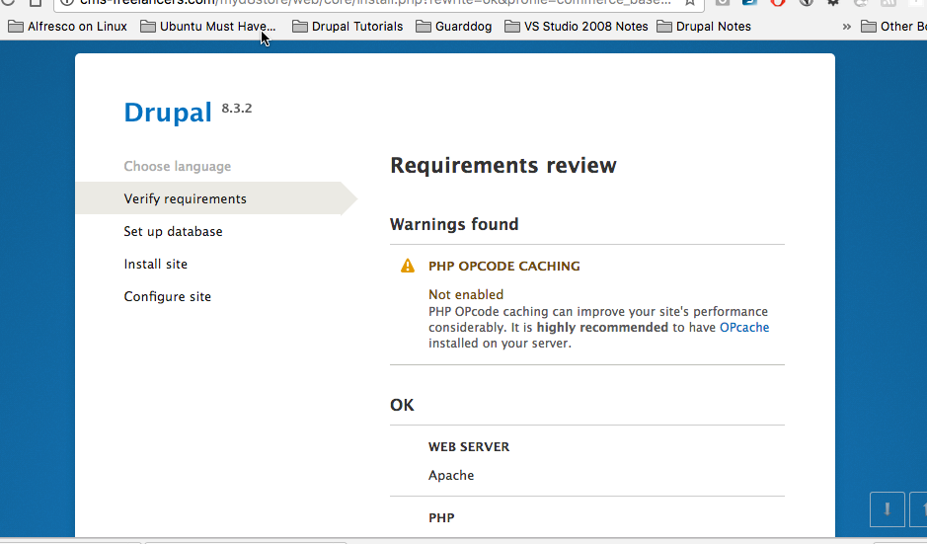
Verify we are OK to install(Scroll down)

Slide 27
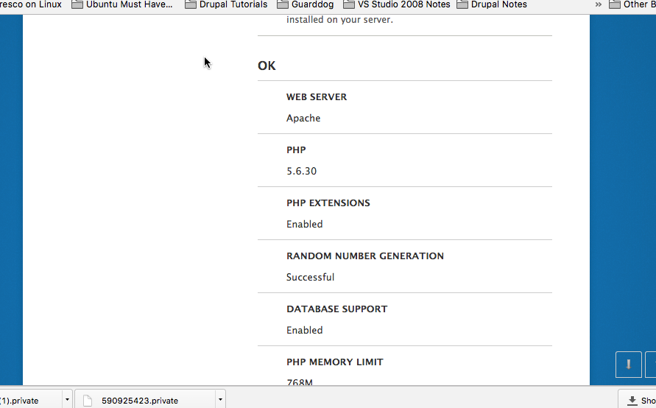

Slide 28
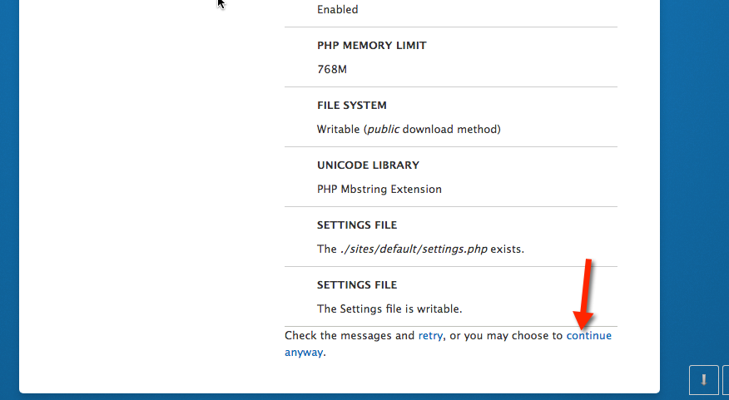
Select continue anyway

Slide 29
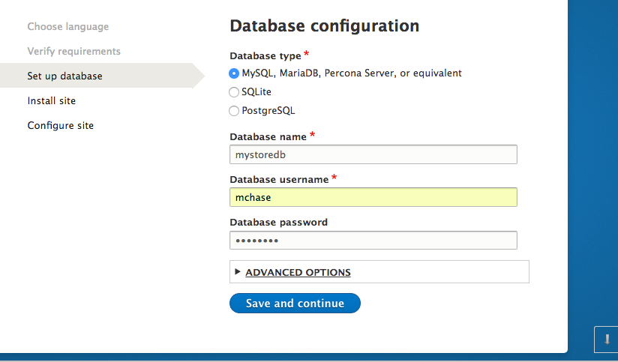
I forgot to put the domain name as prefix on the database name, so the install failed

Slide 30
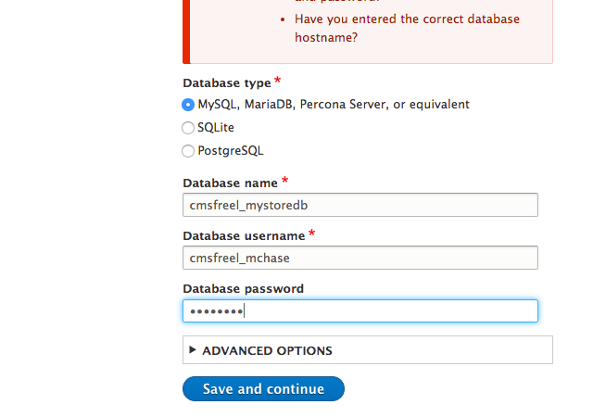
Correct DB and DB username, now the installation can continue

Slide 31
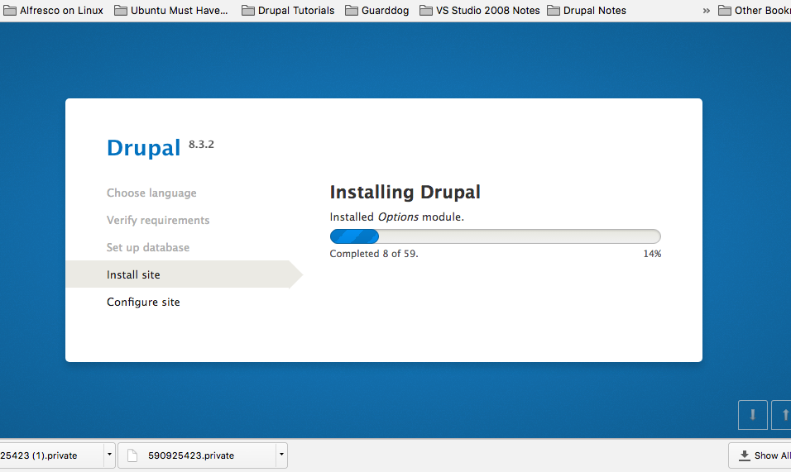
Installing the D8 Site from the downloaded D8 Commerce files

Slide 32
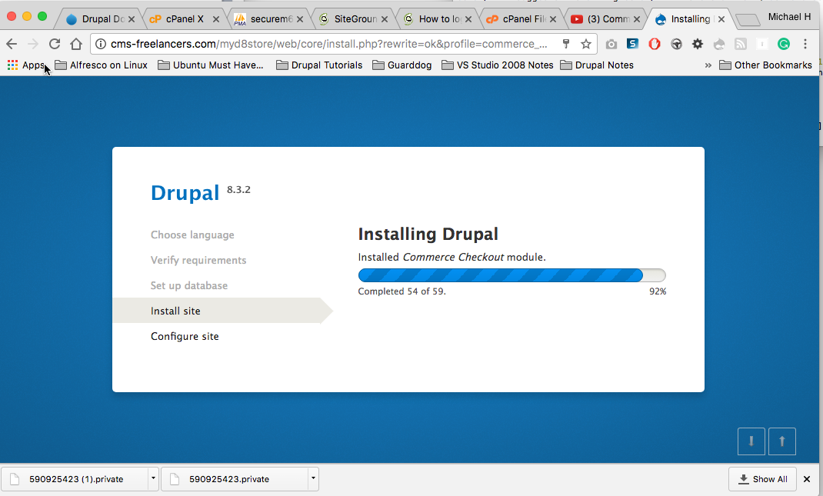
54 of 59

Slide 33
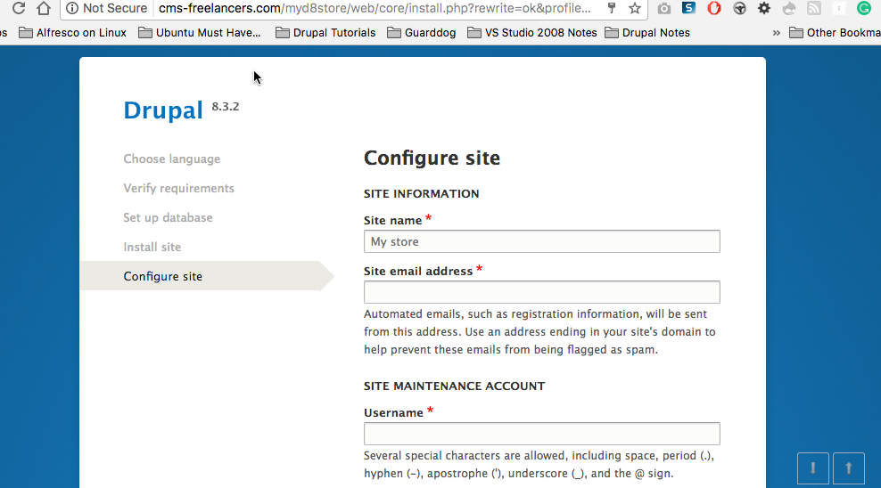
Configure the D8 Site (D8 Not not Commerce)

Slide 34
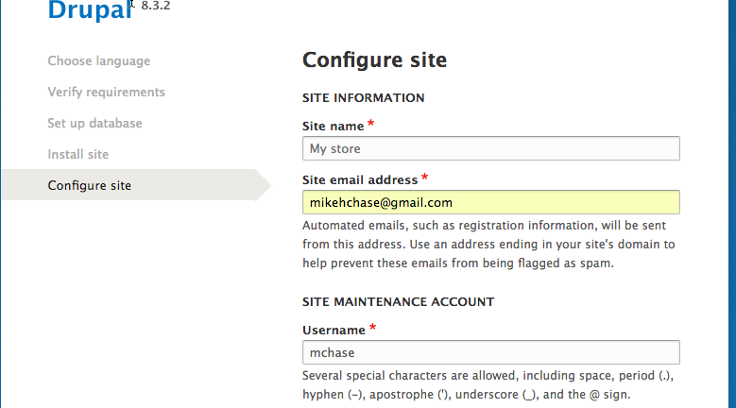
Configure the D8 Site

Slide 35
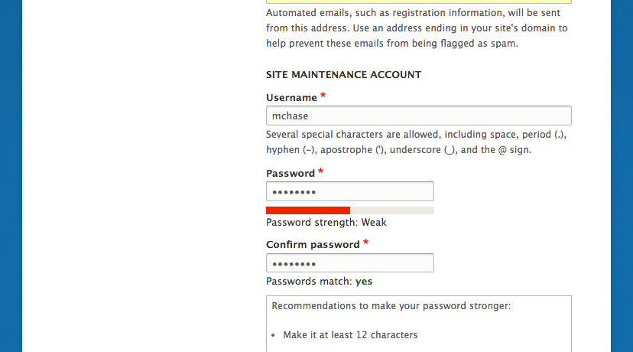
Enter username and password

Slide 36
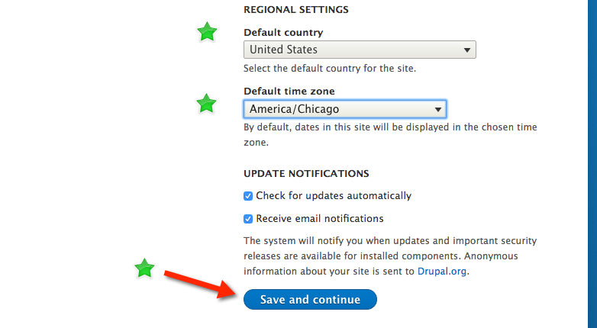
Set Regional settings & Default Time zone

Slide 37
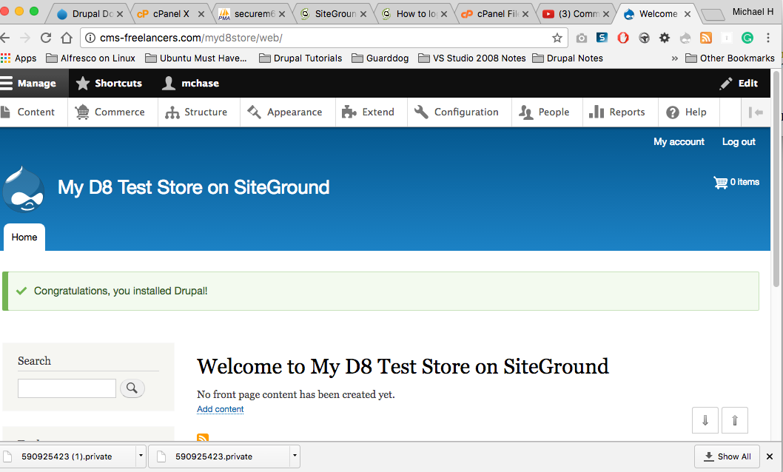
Drupal 8 Site Has been established on SiteGround

Slide 38
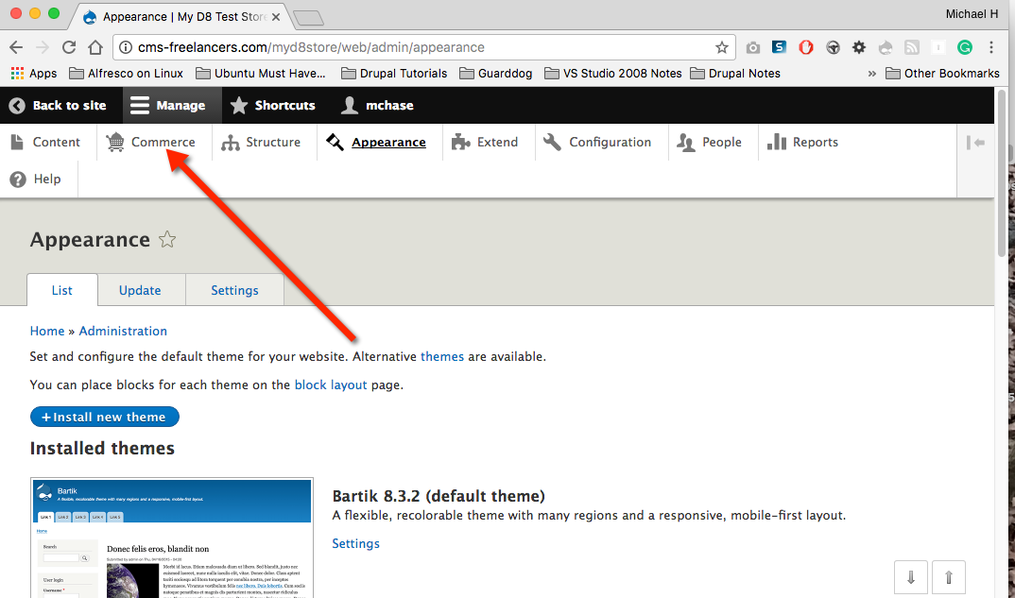
And…We have a menu item for Commerce

Slide 39
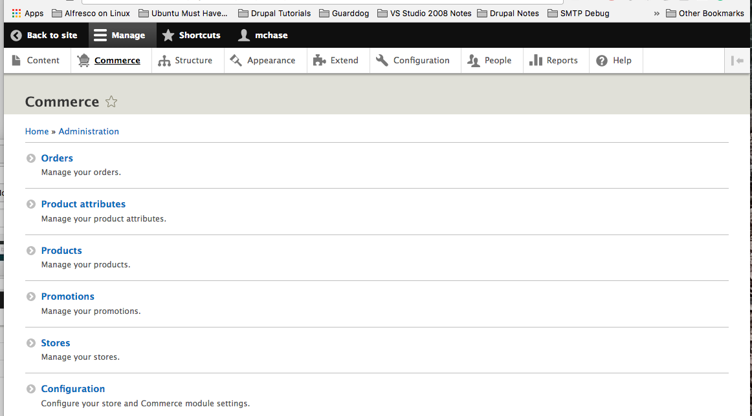
Commerce Options

Slide 40
References
YouTube Video AcroMedia, Josh Miller (2 Parts)
https://www.youtube.com/watch?v=XOy0sR9NPxM
https://www.youtube.com/watch?v=CrJrjgOuvSk
Drupal Commerce Website
Make sure v2 is in the URL for any documentation
http://docs.drupalcommerce.org/introduction.html
http://docs.drupalcommerce.org/v2/getting-started/install.html

Slide 41
Additional Reference Material
Commerce Guys - Drupal Con New Orleans 2106: Creating online store with Commerce on Drupal 8
https://www.youtube.com/watch?v=EQxA3VYal54
Meet Commerce 2.0 Matt Galman - Author Drupal 8 Development Cookbook
Twin Cities Drupal Camp 2016 #TCDrupal
https://www.youtube.com/watch?v=ZrmXllVOiAk
Commerce Guys - Engineering simpler solutions to the hardest parts of selling online
Nov 2016 - Why keep Drupal Commerce, why not keep Drupal as just a front end to Magento and Shopify
https://www.youtube.com/watch?v=BmFFPozHKFU

Slide 42
Next Time – Configuring the Store
Drupal Commerce 2.x with Drupal 8 Basic User Tutorial Part 2 (For Next time)
How to set up a store
https://www.youtube.com/watch?v=0sz4LDgwfGM

